Slide 1
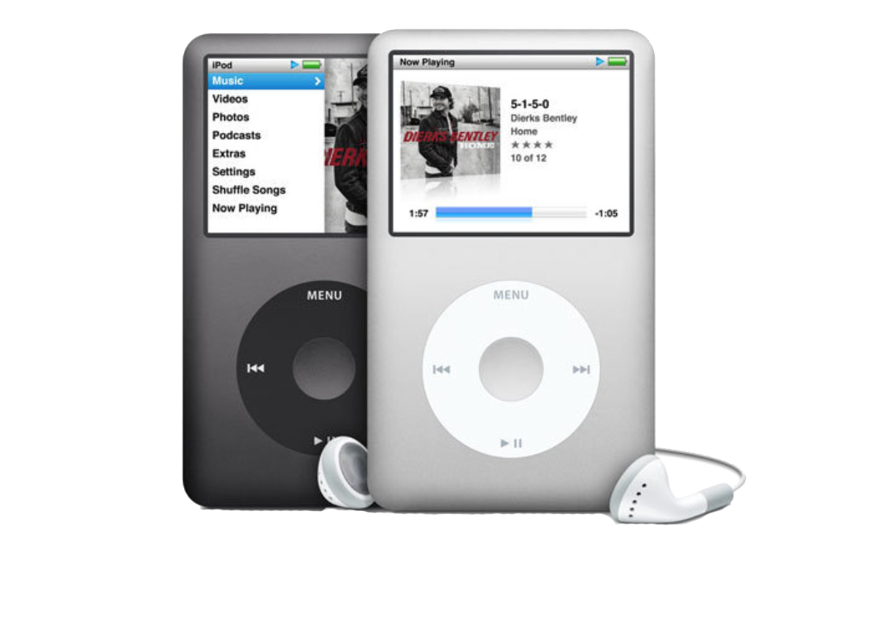
iPod

Slide 2

MP3 music player

Slide 3

CD quality music

Slide 4
MP3
MP3 VBR
WAV
AIFF

Slide 5

1000 songs

Slide 6
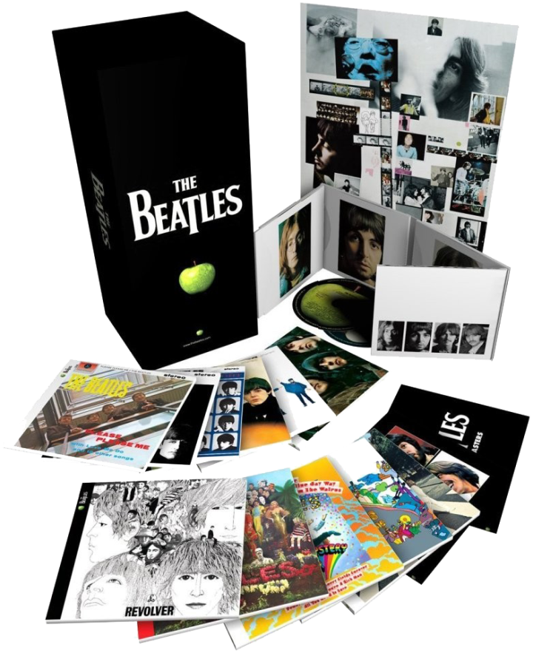
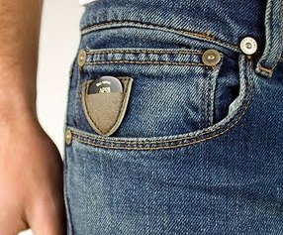
Entire music library fits in your pocket

Slide 7
iPod

Slide 8
1
2
3
Three major
breakthroughs

Slide 9
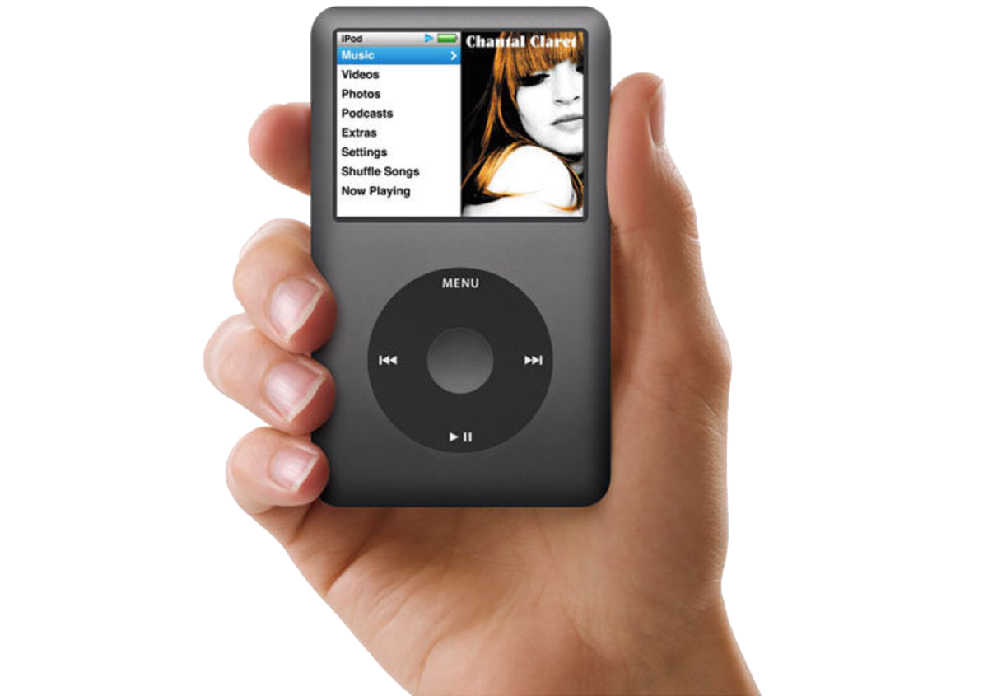
1
Ultra-portable

Slide 10
1000 songs

Slide 11
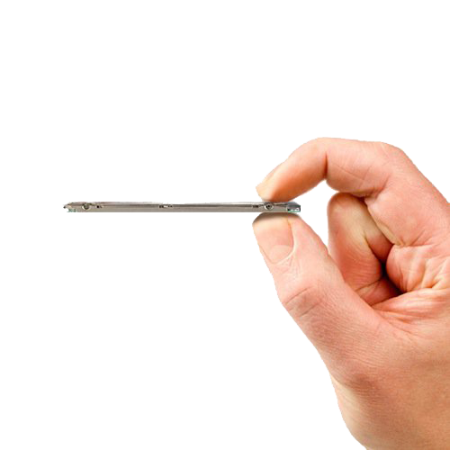
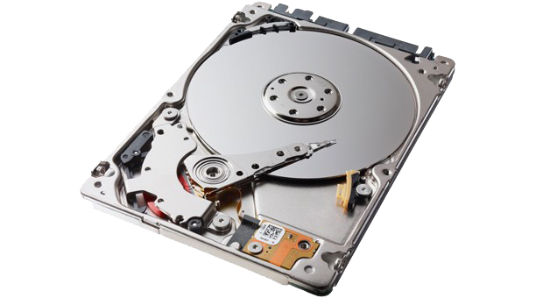
Ultra-thin hard drive
1.8 inch drive is 0.20 inches thick

Slide 12

5 Gigabytes
1000 songs at 160K bit rate

Slide 13

20 minutes
Skip protection

Slide 14
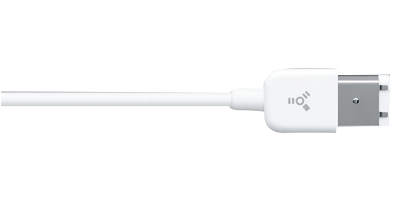
FireWire
First and only music player with FireWire

Slide 15
Fast
Download an entire CD
in under 10 seconds

Slide 16
 | FireWire | USB
CD | 10 seconds | 5 minutes
1000 Songs | 10 minutes | 5 hours
Music download speed

Slide 17
30 times faster
than every other MP3 player

Slide 18

10 hours
Continuous music playback

Slide 19
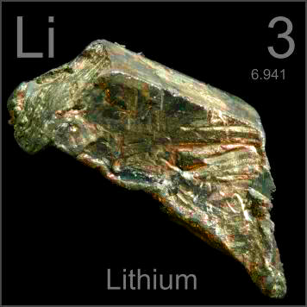
10 hours
Rechargeable lithium-polymer battery

Slide 20

One hour
Fast charge to 80% of capacity

Slide 21
Charges over FireWire
Recharges whenever it’s connected

Slide 22
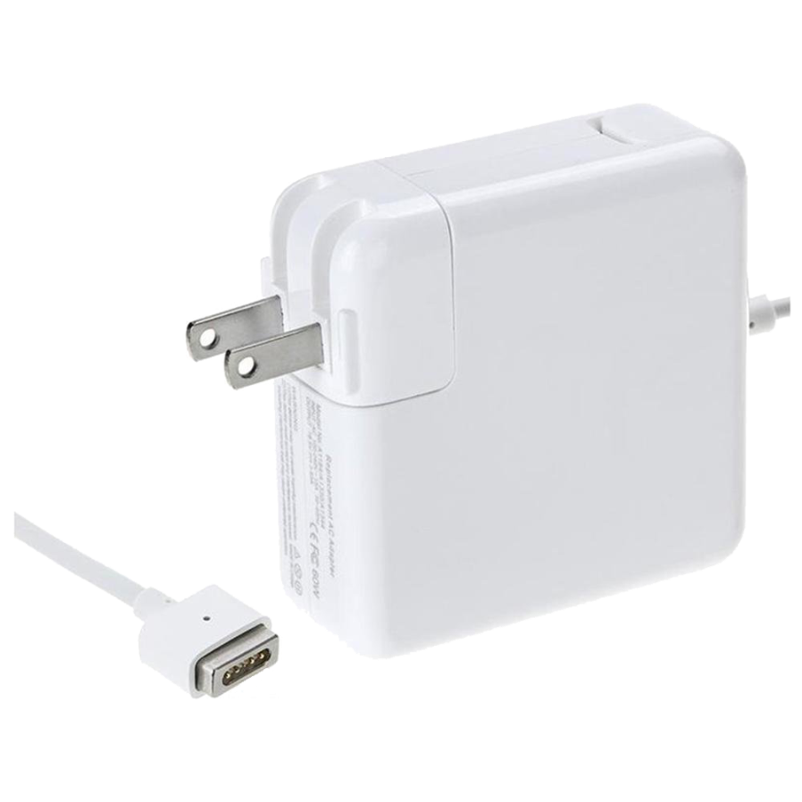
Charger

Slide 23
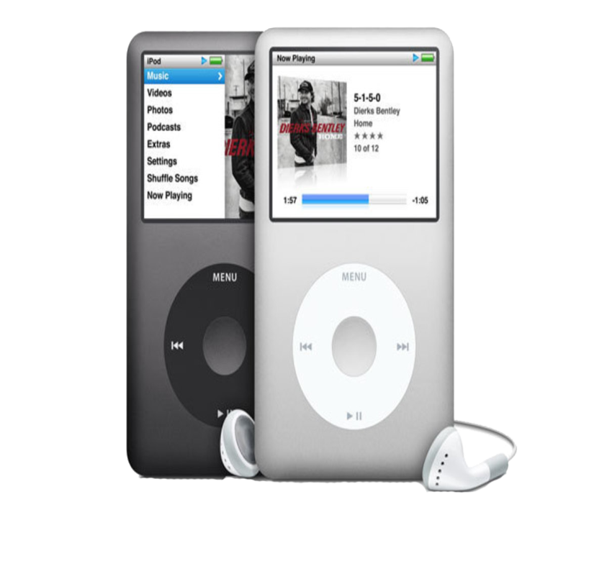
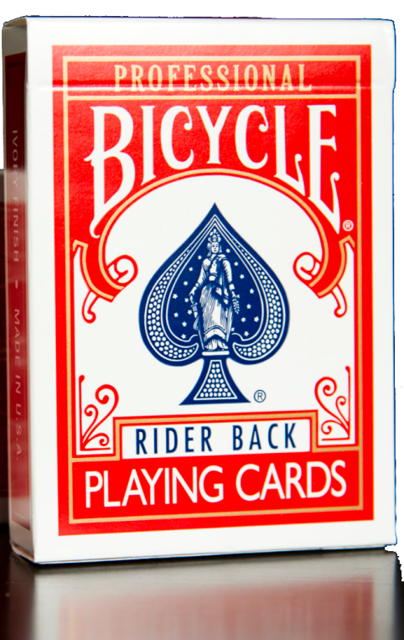
0.78”
2.1”
4.0”
iPod Size

Slide 24
iPod Weight:
6.5 oz
Lighter than most cell phones

Slide 25
